Slide 1


Mastering NumPy for Beginners
Welcome to this beginner-friendly guide to NumPy! We'll explore this essential library for image processing and data science from installation to practical application.
by EMRE Akpınar

Slide 2

What is NumPy?
1
Numerical Python
2
Mathematical Operations
NumPy stands for "Numerical Python." It's a fundamental library for working with large arrays and matrices.
It enables complex mathematical operations on these arrays. It's widely used in data science today.
3
Open-source
NumPy is free and open-source. Anyone can use it without paying.

Slide 3
Understanding Arrays
1D Arrays
2D Arrays
3D Arrays
Think of these as a single row of elements. Like a simple list of numbers in a line.
Elements arranged in rows and columns. Similar to a spreadsheet or table format.
Like stacking multiple 2D arrays. They add depth to the rows and columns structure.

Slide 4

Getting Started with NumPy
Install NumPy
Open your terminal or command prompt. Type: pip install numpy
Import the Library
In your Python script, add: import numpy as np
Create Your First Array
Try: arr = np.array([1, 2, 3, 4, 5])
Print and Verify
Use print(arr) to see your array.

Slide 5
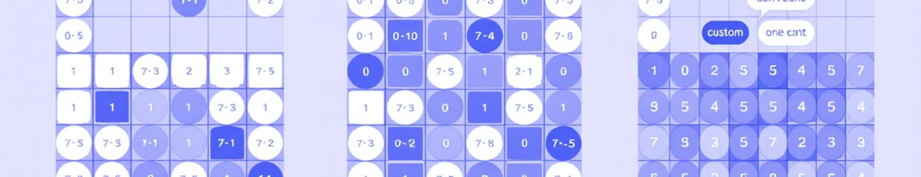



Creating Arrays with Default Values
Zeros Array
Ones Array
Custom Values
zeros_array = np.zeros((3, 4)) creates a 3x4 grid filled with zeros.
ones_array = np.ones((3, 4)) generates a similar grid but with ones.
filled_array = np.ones((3, 4)) * 5 makes an array filled with fives.

Slide 6
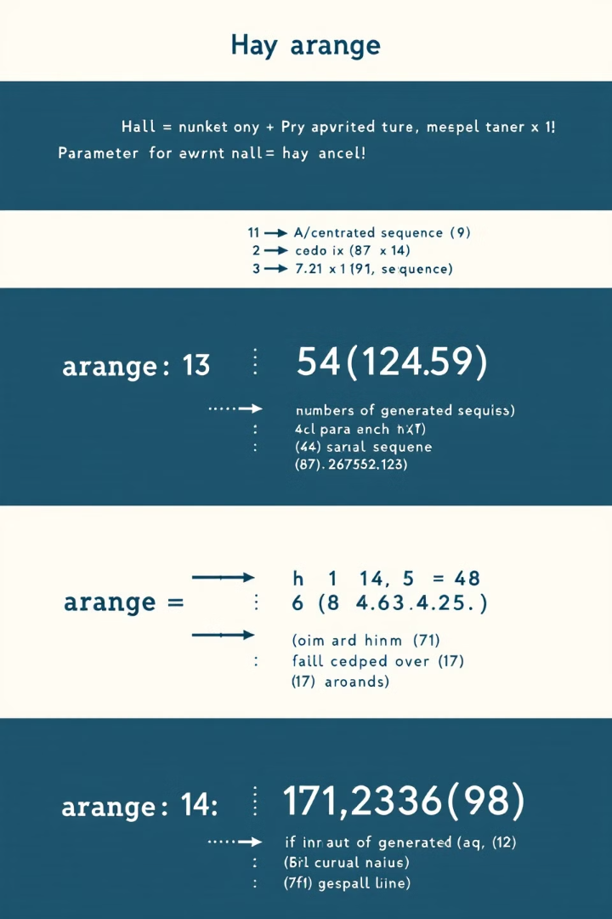


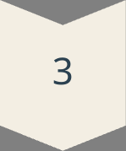
Generating Number Sequences
Basic Range
sequence = np.arange(12) creates numbers from 0 to 11.
Custom Start
Start from any number like 10: np.arange(10, 100).
With Step Size
np.arange(10, 100, 10) creates: 10, 20, 30... 90.

Slide 7
Reshaping Arrays
Create 1D Array
1
array_1d = np.arange(12)
Reshape Operation
2
reshaped_array = array_1d.reshape(4, 3)
Result: 2D Array
3
A 4x3 matrix from 12 elements

Slide 8
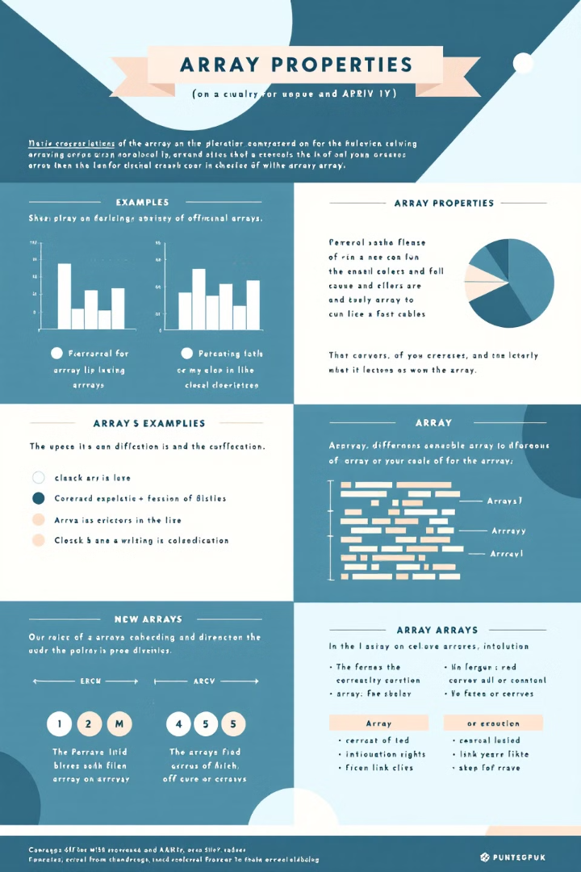
Array Properties
Property
Description
Example
ndim
Number of dimensions
array_2d.ndim → 2
shape
Size in each dimension
(2, 3) → 2 rows, 3 columns
size
Total number of elements
array_2d.size → 6
dtype
Data type of elements
int32, float64, etc.

Slide 9
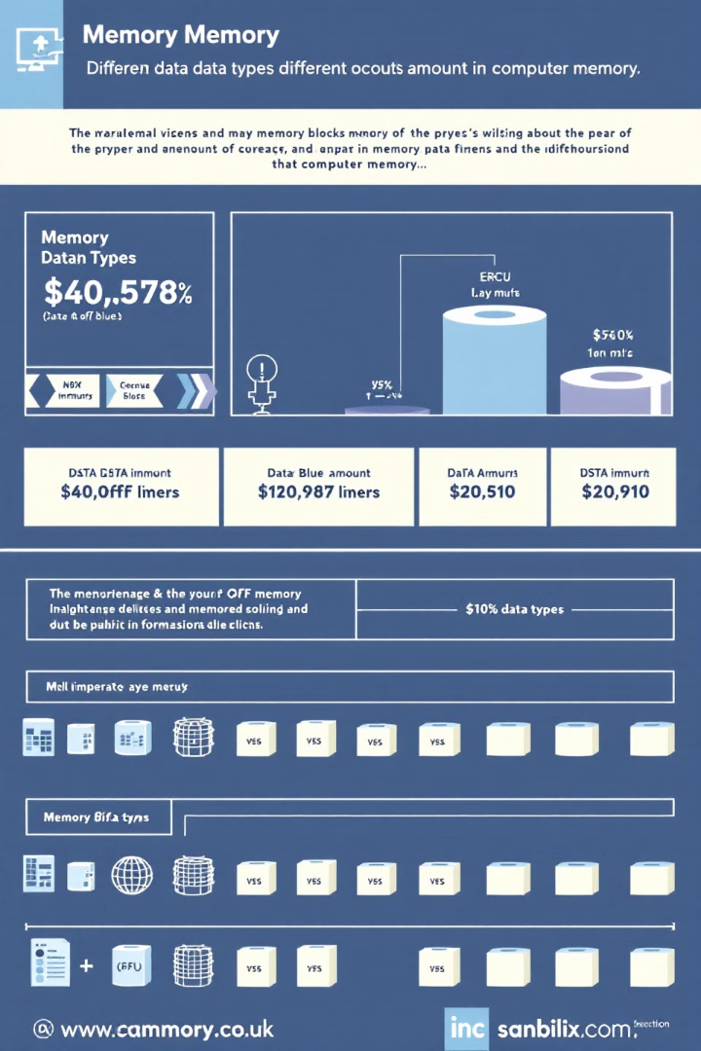
Setting Data Types
Integer Types
Float Types
array = np.array([2, 3, 4, 5], dtype=np.int8)
array_float = np.array([2, 3, 4, 5], dtype=np.float16)
Smaller memory footprint for integers from -128 to 127.
For decimal numbers with reduced precision.
Why Set Types?
Controls memory usage and precision. Important for large datasets and performance.

Slide 10




Practical Applications
Image Processing
1
Manipulate pixels as NumPy arrays
Data Analysis
2
Perform statistical operations efficiently
Machine Learning
3
Prepare and transform data
Scientific Computing
4
Solve complex mathematical problems

